Slide 1
LOGISTIC REGRESSION
Jenny Doyle - April 11, 2017

Slide 2
AGENDA
Titanic Survival example
Linear Regression
Model assumptions
Generalized Linear Models
Logistic Regression
Python Implementation

Slide 3
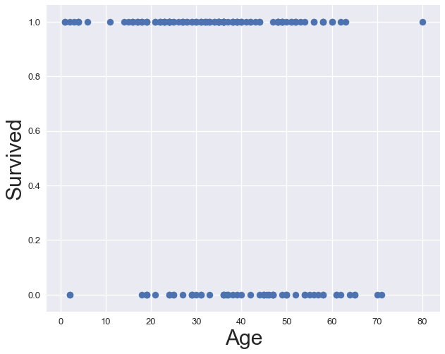
TITANIC SURVIVAL BASED ON AGE

Slide 4
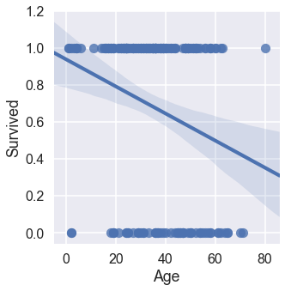
TITANIC SURVIVAL BASED ON AGE
LINEAR REGRESSION- LINE OF BEST FIT?

Slide 5
LINEAR MODEL ASSUMPTIONS
Linearity of relationship between dependent and independent variables
Independence of residuals
Normality of residuals
Equality of Variances of residuals

Slide 6
LINEAR MODEL ASSUMPTIONS
Linearity of relationship between dependent and independent variables
Independence of residuals
Normality of residuals
Equality of Variances of residuals

Slide 7
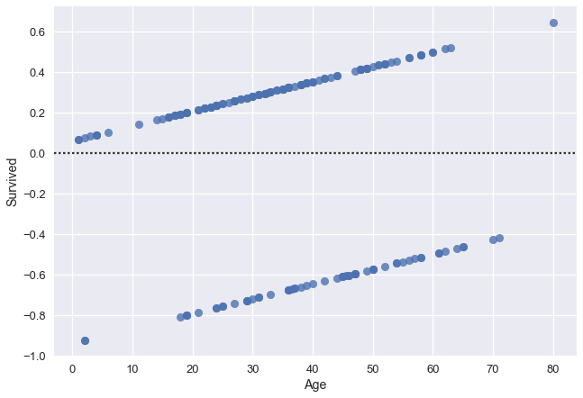
RESIDUALS
LINEAR REGRESSION

Slide 8
LINEAR MODEL ASSUMPTIONS
Linearity of relationship between dependent and independent variables
Independence of residuals
Normality of residuals
Equality of Variances of residuals

Slide 9
GENERALIZED LINEAR MODEL
Linear Component- relationship between X and y
Link Component- transformation of linear regression line
Random Component- error distribution

Slide 10
WHAT IS LOGISTIC REGRESSION?
⭐RANDOM COMPONENT -
binomial distribution
Generalized linear model
Binary, mutually exclusive dependent variable
Independent variables can be either categorical or numerical
Models the probability that y = 1 given x values

Slide 11
LOGISTIC REGRESSION ASSUMPTIONS
The independent variables are independent of one another
The observations are independent of one another
There is no measurement error in our observations
The independent variables are linearly related to the log=odds that Y = 1

Slide 12


GENERALIZED LINEAR MODEL
LOGISTIC FUNCTION
LINEAR FUNCTION
⭐LINEAR COMPONENT

Slide 13


MODEL CHARACTERISTICS
⭐ LINK COMPONENT
Logit: inverse of logistic function

Slide 14

MODEL CHARACTERISTICS
β₁, β₂ are the coefficients, the log of the odds ratios
e^{β1}, e^{β2}, ... are the odds ratios
Interpretation: as X increases by one unit, y is e^{β} times as likely to have the probability y = 1

Slide 15
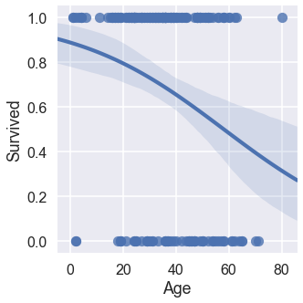
TITANIC SURVIVAL BASED ON AGE
LOGISTIC REGRESSION-
LOGIT FUNCTION

Slide 16

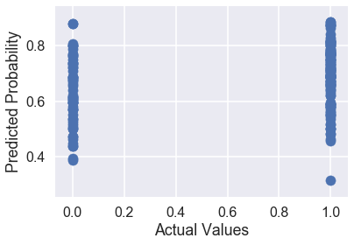
TITANIC SURVIVAL BASED ON AGE
LOGISTIC REGRESSION -
RESIDUALS

Slide 17
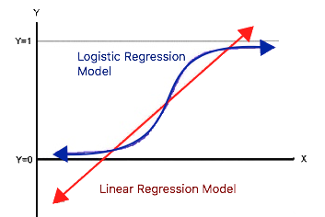
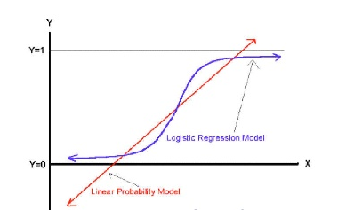

Slide 18
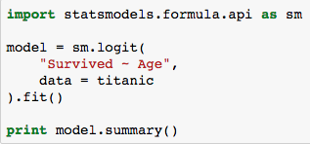
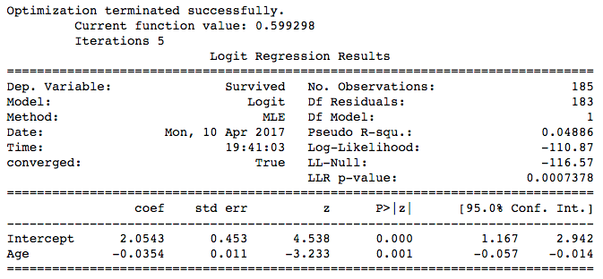
LOGISTIC REGRESSION
WITH STATSMODELS

Slide 19
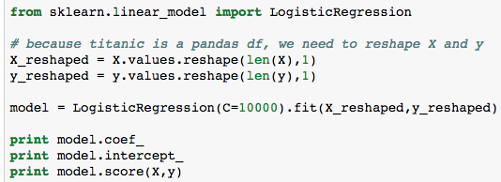

LOGISTIC REGRESSION
WITH SKLEARN

Slide 20
Questions?

